Slide 1

Software Engineering
Software Project Management, Architecture & Design
Software Project Management
Department of Computer Science and Engineering
Acknowledgement: Dr. Phalachandra HL, Prof. Anand MS, authors of the prescribed textbooks and materials sourced online.

Slide 2

Project Organisation and WBS
List of Contents
Project Organisation
Organisational Structure
Types of Organisational Structure
Features of an Organisational Structure
WBS : Work Breakdown Structure
Types of WBS : Deliverable and Phase based
Elements of WBS
Steps to create a WBS
Department of Computer Science and Engineering

Slide 3
Project Organisation
Project organization involves systematically arranging roles, responsibilities, tasks, and timelines to ensure a clear and efficient project workflow.
A well-organized project improves efficiency, reduces confusion, and ensures that all team members are aligned with project goals.

Slide 4
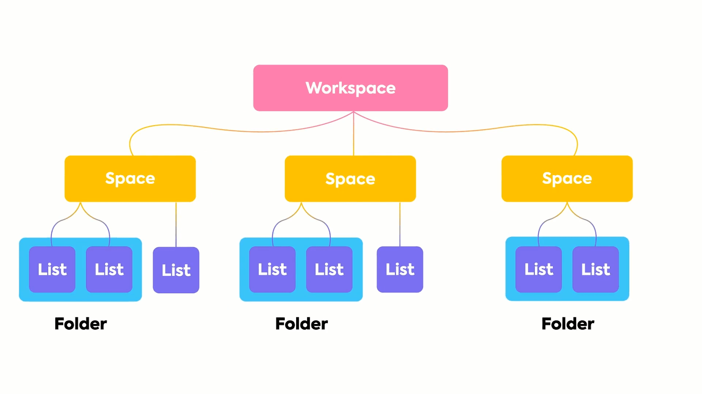
Organisational Structure
1. Workspace: The top-level view representing your entire organization, giving an overview of everything.
2. Spaces: Separate areas within the Workspace for different departments, teams, or projects, each with its own settings and permissions.
3. Folders: An extra layer within Spaces to group related Lists and Tasks, useful for organizing complex workflows.
4. Lists: Containers for work items, holding tasks that contribute to a specific goal, either within a Space or organized in Folders.
5. Tasks: Actionable items within Lists that need to be completed, assigned to team members, and managed with deadlines and priorities.

Slide 5
Types of Organisational Structure
1.Functional Structure
2. Projectized Structure
3. Matrix Structure
Projects managed within departments (e.g marketing, finance).
Department heads lead, with decision-making aligned to departmental goals.
Pros: Leverages specialized expertise.
Cons: Can lead to siloed operations and slow decision-making.
Teams formed solely for the project, reporting to a project manager.
Project manager has full authority over resources and decisions.
Pros: Focused effort, clear leadership.
Cons: Resource allocation challenges when handling multiple projects.
Dual reporting: Employees report to both functional managers and project managers.
Shared authority between project and functional managers.
Pros: Flexibility, dynamic collaboration.
Cons: Potential for confusion and conflicts due to dual authority.

Slide 6
Features of an Organizational Structure
1. Hierarchy: Establishes a clear chain of command for smooth communication.
2. Division of Labor: Breaks down complex projects into manageable tasks and assign tasks based on expertise, enhancing efficiency.
3. Roles: Ensures each team member understands their role in the project.
4. Transparency and Communication: Builds trust and keeps everyone informed and aligned.
5. Work Efficiency: Increases productivity by reducing duplication of effort.

Slide 7
Work Breakdown Structure

Slide 8
WBS : Work Breakdown Structure
A work breakdown structure (WBS) is a project management tool that methodically breaks down complex projects into smaller, more manageable tasks.
By decomposing the project into smaller components, a WBS can consolidate scope, cost, and deliverables into one cohesive tool.
Each descending level represents an increasingly detailed definition of the project work.
A work breakdown structure serves as your map through complicated projects

Slide 9
Types of WBS
There are two types of WBS :
1] Deliverable based
2] Phase based
Depending on whether you want to organize your project by time or scope, you can choose the most suitable WBS type.

Slide 10
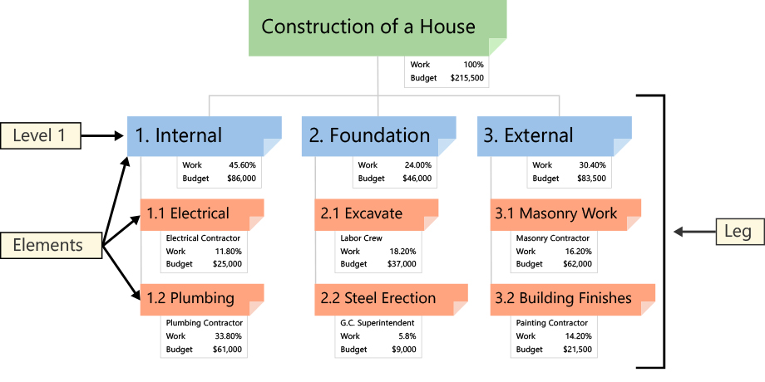
Deliverable based WBS
Breaks down the project into major deliverables and work packages.
Structure:
Starts with major control accounts representing project scope.
Divides these into specific deliverables and work packages.
Notes:
Physical component needed to complete overall project

Slide 11
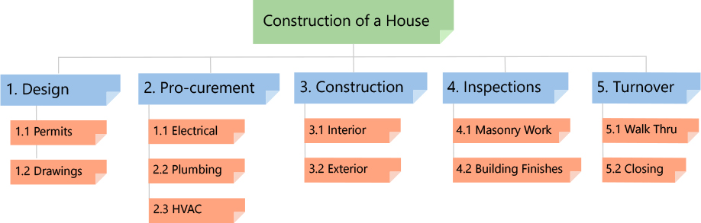
Phase based WBS
Organizes the project according to phases and stages.
Structure:
Displays the final deliverable at the top.
Breaks down into five key phases: initiation, planning, execution, control, and closeout.
Each phase is further divided into deliverables and work packages.

Slide 12
Elements of WBS
1. WBS Dictionary: Defines WBS elements and terminology.
2. WBS Levels: Hierarchical levels showing deliverables, control accounts, and work packages.
3. Control Accounts: Groups work packages and measures their status.
4. Project Deliverables: Outcomes of tasks and work packages.
5. Work Packages: Lowest level of WBS; group of related tasks.
6. Tasks: Components of work packages; includes requirements, status, and duration.

Slide 13
Steps to create a WBS
Define Project Scope, Goals, and Objectives
Identify Project Phases & Control Accounts
List Project Deliverables
Set WBS Levels: Hierarchical levels from final deliverable to tasks and work packages.
Create Work Packages:
Break deliverables into tasks and subtasks.
Group tasks into work packages.
Choose Task Owners:
Assign tasks to team members.
Provide necessary tools, resources, and authority.

Slide 14
THANK YOU
Software Project Management
Department of Computer Science and Engineering
14

